Slide 1

Corporate Finance Lecture 1: NPV and Basic Concepts of Corporate Finance
Yuan Shi ©
HSBC Business School
Peking University

Slide 2
Today
Feedback to survey
Valuation basics:
Discounting and NPV

Slide 3
Class design
Valuation basics
Accounting basics
Capital budgeting
Equity/Bond market and valuation
Capital structure
Special topics:
VC, PE, IPO, SEO, Right Offering

Slide 4
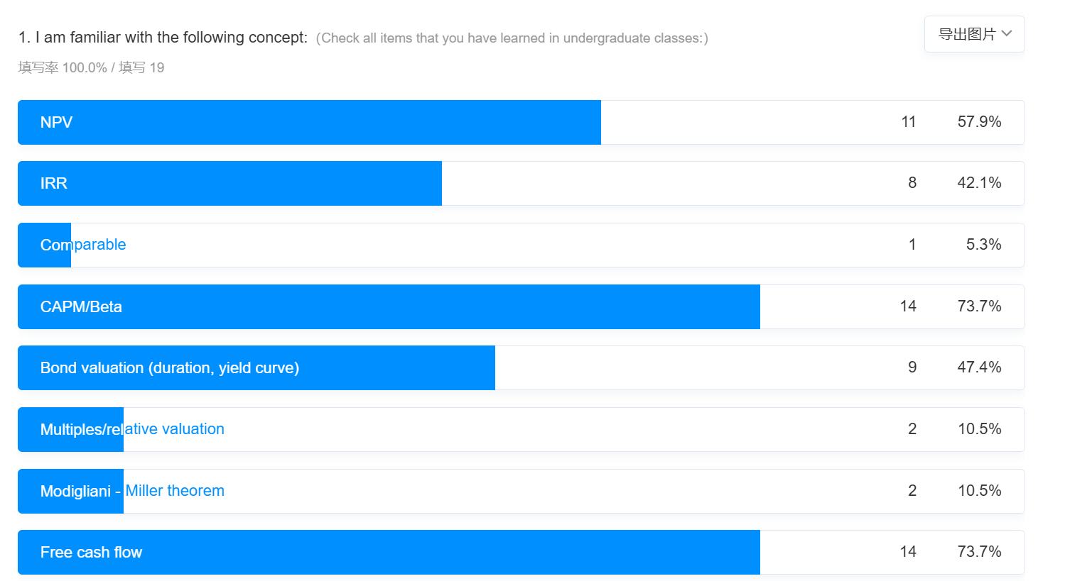
Survey feedback: background
Valuation and capital budgeting
Accounting basic
Equity/Bond valuation
Capital structure

Slide 5
Survey feedback: career development
Security research: 30%
PE/VC: 20%
Trading: 25%
Quant finance: 25%

Slide 6
Lecture feedback
22% found class progressed too fast
36% found the English lecturing too fast
I’ll try to add more Chinese translation when necessary
Summarize class materials at the end of the class
Simulated exercise
And also real world examples

Slide 7
About the group project

Slide 8
Last class
Introduction to corporate finance.
What is finance?
What is corporation? How is it different from proprietorship 独资企业 and partnerships 合伙人?
Limited liability
How easy/difficult is the transfer of ownership
Tax treatment
What are corporate finance decisions?
Goal of corporations

Slide 9
Simulated exam questions
True or false: general partners are protected by limited liability
Give me one example of corporate payout decisions
Explain in one example how the rise of ESG investment is not conflicted with the company’s purpose of maximizing shareholder value

Slide 10
This class
Valuation basics
Time value of Money: Discounting
Present value and future value
Calculating multiple cash flows

Slide 11
A quick summary of last class
Understanding value is important in many finance applications
Value is difficult because a lot of cash flows happen across different time periods
We want to understand the value of the assets at current period (present value)
The technique allowing exchange of value across time periods: discounting 折现
Idea: holding one RMB today is the same as holding 1+r tomorrow

Slide 12
A quick summary of last class
Understanding value is important in many finance applications
Value is difficult because a lot of cash flows happen across different time periods
We want to understand the value of the assets at current period (present value)
The technique allowing exchange of value across time periods: discounting 折现
Idea: holding one RMB today is the same as holding 1+r tomorrow

Slide 13
What is Value?
In the context of financial economics:
An asset creates value for its owner if it generates a positive value of cash flows.
Cash Flows
Cash Flows occur in the future
Unless contractually fixed, cash flows need to be forecasted
For non-financial assets (e.g., cash flows from investment projects), cash flows can be conceptually challenging.

Slide 14
Value-related Decision
Acquire an asset in exchange for future cash flows
Corporate Manager
Invest in real assets which generates future cash flows
Investors
Invest in financial assets which entitle the owner to future payments
Bond/Loan: Principal & Interest
Stock: Dividend and Capital Gain
How to judge a good deal?

Slide 15
To the Strategic Board
As per the annual strategy review, and the concerns raised during the (very productive!) November 2020 retreat by the Head of Marketing notwithstanding, as management of the Shenzhen facility we believe the inputs could be sourced at a cost of $100,000 or so, an amount that our suppliers would be amenable to given the current economic environment. After netting out operating expenses (including salaries), sales would then leave a revenue at year-end of almost surely $105,000. We are thus backing the project and recommend to start approaching our suppliers ASAP.

Slide 16
To us…
blah blah blah blah blah blah blah blah blah blah blah blah blah blah blah blah blah blah blah blah blah blah blah blah blah blah blah blah blah blah blah blah blah blah blah blah blah blah blah blah blah blah blah blah blah cost of $100,000 blah blah blah blah blah blah blah blah blah blah blah blah blah blah blah blah blah blah blah blah blah blah blah blah blah blah blah blah blah blah blah blah blah blah blah revenue at year-end of almost surely $105,000 blah blah blah blah blah blah blah blah blah blah blah blah blah blah blah blah blah blah blah blah

Slide 17
Time Value of Money
First year
Second year
Date
0
1
2
Cash flow
-$100,000
$105,000
$0
Key Issues:
Cash flows typically occur over time.
Time value of money implies that we cannot simply add dollar amounts that occur at different points in time.
Dollar today is not the same as dollar one year later. Why?

Slide 18
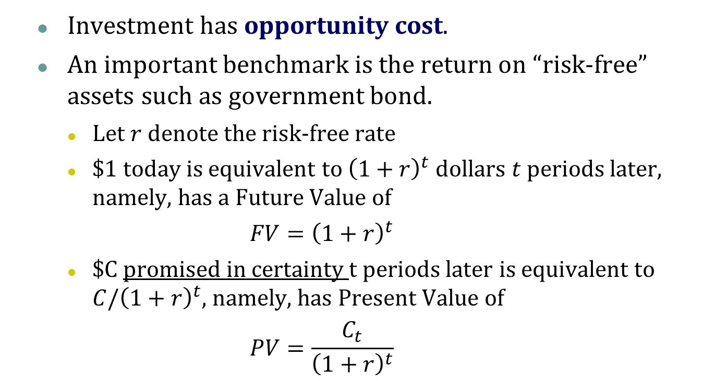
Time Value of Money
Investment has opportunity cost.
An important benchmark is the return on “risk-free” assets such as government bond.
Let $r$ denote the risk-free rate
$1 today is equivalent to ${\left(1+r\right)}^{t}$ dollars $t$ periods later, namely, has a Future Value of
$$FV={\left(1+r\right)}^{t}$$
$C promised in certainty $t$ periods later is equivalent to $C/{\left(1+r\right)}^{t}$, namely, has Present Value of
$$PV=\frac{C_{t}}{{\left(1+r\right)}^{t}}$$

Slide 19
Time Value of Money
First year
Second year
Date
0
1
2
Cash flow
-$100,000
$105,000
$0
Present Value of $105,000
Competitive financial market
Borrow/ invest at risk-free rate of 3%
Value today: $105,000/(1+3%) = $101,942
Net Present Value:
the net value added by the investment
$101,942 - $100,000 = $1,942 >0

Slide 20
Multiple Years
Date
0
1
2
…
K
…
T
Cash flow
C₁
C₂
…
C_{K}
…
C_{T}
C_{K}:
Date K; End of year K; K years later; K years from now

Slide 21
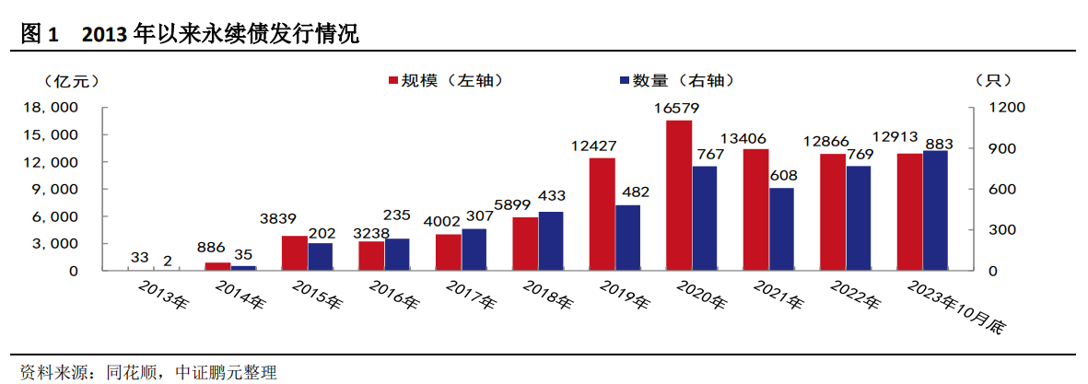
Special Cases
Annuity 定期年金
Cash flows are constant for T periods: C₁=C₂=…=C_{T}
Application: debt coupon payment
Perpetuity 永续年金
Infinite series of equal payments: C₁=C₂=..=C_{T}=C_{T+1}=..
Application: perpetuity debt 永续债, preferred stock 优先股

Slide 22
Special Cases
Growing Annuity 增长年金
C_{t+1}=(1+g)C_{t}
Cash flows that are growing at a constant rate
Growing Perpetuity 永续增长年金
Infinite series of cash flows that are growing at a constant rate
Application: firm valuation, government sustainability analysis

Slide 23
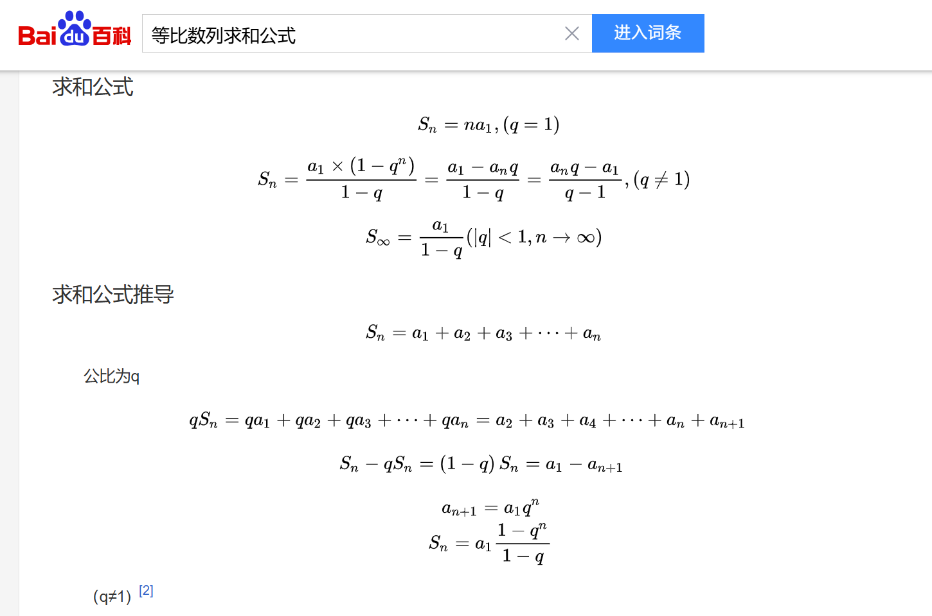

Slide 24
Special Cases
g > 0%
g = 0% (No growth)
Annuity
Perpetuity

Slide 25
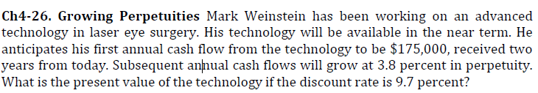
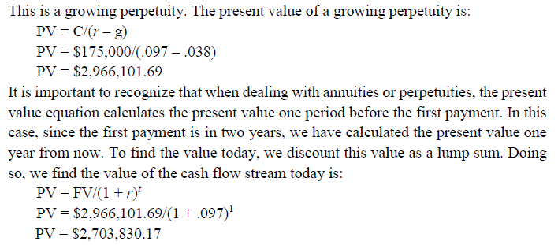
Exercise
Try it!
Solution：

Slide 26
Almost Surely?
blah blah blah blah blah blah blah blah blah blah blah blah blah blah blah blah blah blah blah blah blah blah blah blah blah blah blah blah blah blah blah blah blah blah blah blah blah blah blah blah blah blah blah blah blah cost of $100,000 blah blah blah blah blah blah blah blah blah blah blah blah blah blah blah blah blah blah blah blah blah blah blah blah blah blah blah blah blah blah blah blah blah blah blah revenue at year-end of almost surely $105,000 blah blah blah blah blah blah blah blah blah blah blah blah blah blah blah blah blah blah blah blah

Slide 27
Recap: Time Value of Money
Investment has opportunity cost.
An important benchmark is the return on “risk-free” assets such as government bond.
Let $r$ denote the risk-free rate
$1 today is equivalent to ${\left(1+r\right)}^{t}$ dollars $t$ periods later, namely, has a Future Value of
$$FV={\left(1+r\right)}^{t}$$
$C promised in certainty $t$ periods later is equivalent to $C/{\left(1+r\right)}^{t}$, namely, has Present Value of
$$PV=\frac{C_{t}}{{\left(1+r\right)}^{t}}$$

Slide 28
Risky Cash Flows
What are risky cash flows?
Investment A generates cash flow of $105 with certainty next year. (Risk-free)
Investment B’s cash flows as follows are risky.
110
0.5
Expected Payment =
0.5*110+0.5*100=105
0.5
100

Slide 29
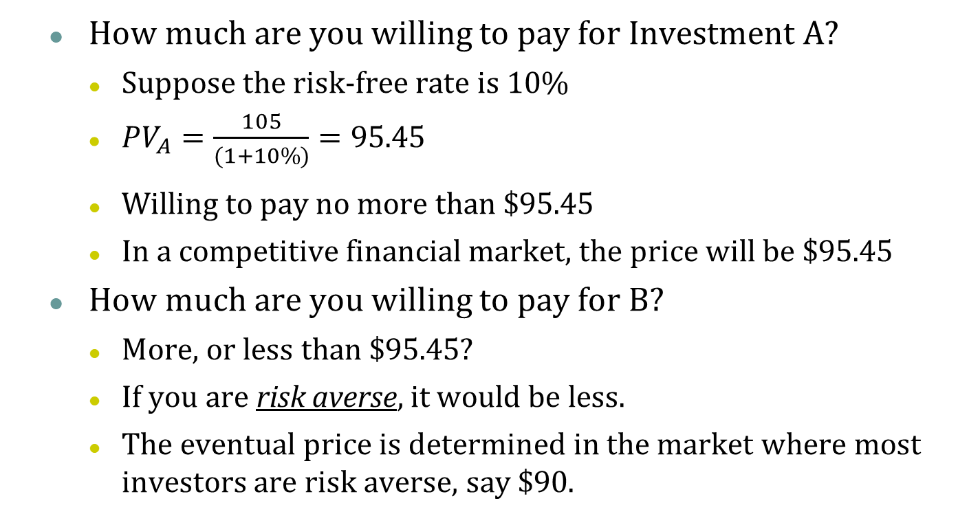
Risky Cash Flows
How much are you willing to pay for Investment A?
Suppose the risk-free rate is 10%
$PV_{A}=\frac{105}{(1+10\%)}=95.45$
Willing to pay no more than $95.45
In a competitive financial market, the price will be $95.45
How much are you willing to pay for B?
More, or less than $95.45?
If you are risk averse, it would be less.
The eventual price is determined in the market where most investors are risk averse, say $90.
Notes:
“Willing to pay” is not the same as what you actually pay. This is important and will come up soon – stay tuned!

Slide 30
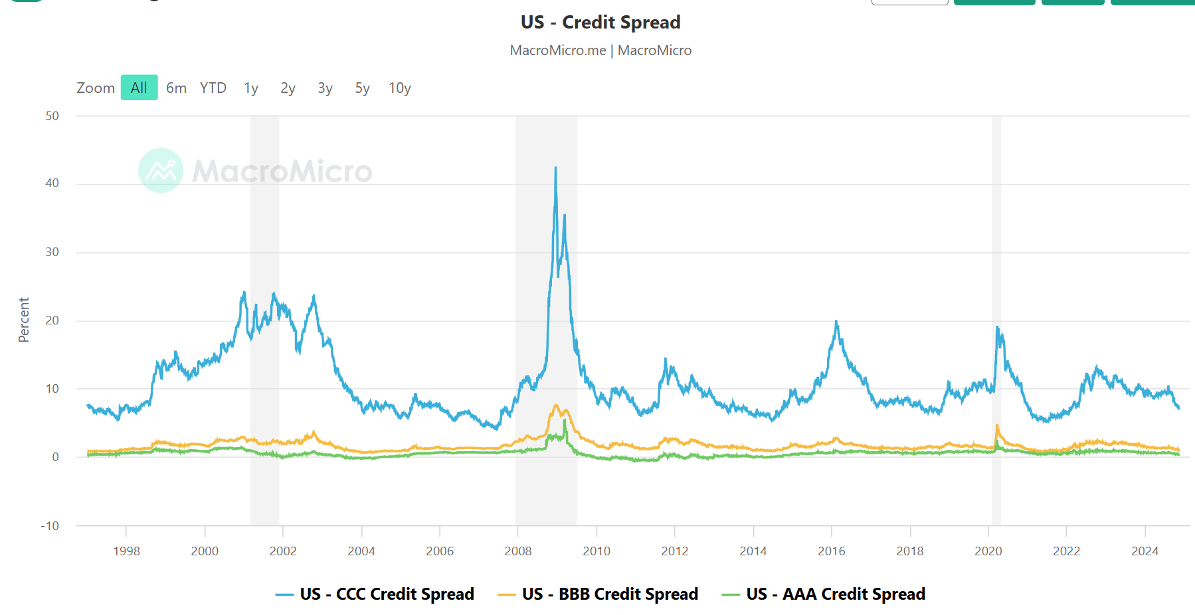
Risk Premium
The discount rate for risk-less securities and risky securities are different
e.g. credit spread
Notes:
US Credit Spread = Merrill Lynch High-Yield Bond Yield – US 10-Year Bond Yield (risk-free interest rate). This spread reflects the market's expectations of future corporate default risk. High-yield bonds are issued by companies with lower credit ratings (below BBB). Due to the higher credit risk associated with these bonds, their yield spread tends to be greater than that of investment-grade bonds. Credit risk spreads have an inverse relationship with the stock market. When companies are performing well, future cash flow growth increases, and default risk decreases (lower credit risk), leading to a narrower spread and a rising stock market. Conversely, during risk events that heighten corporate default risk (higher credit risk), the spread widens, and the stock market tends to decline.

Slide 31
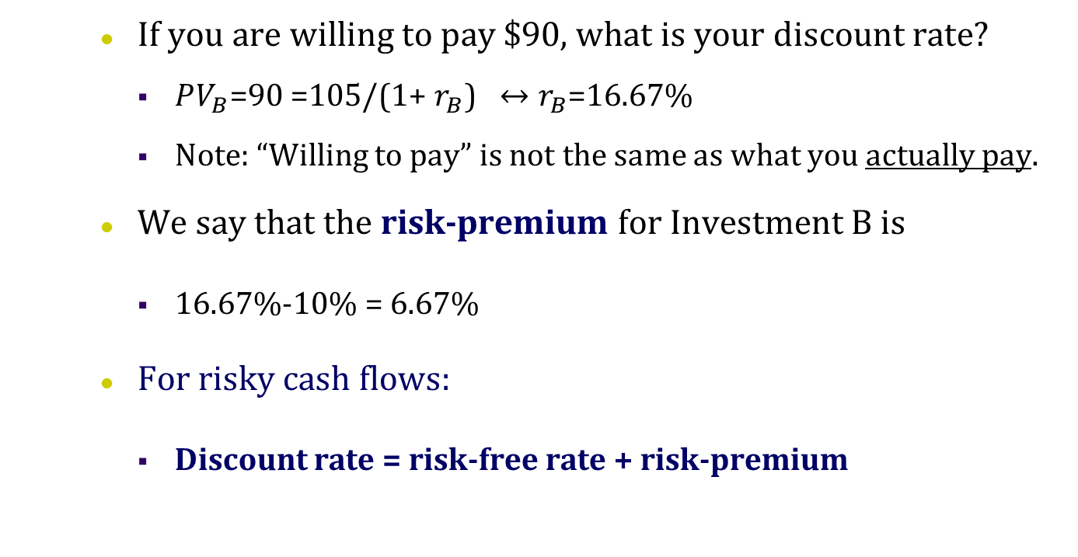
How is discount rate for risky asset calculated?
If you are willing to pay $90, what is your discount rate?
$PV_{B}\text{=90 =105/(1+ }r_{B}\text{)} ↔r_{B}$=16.67%
Note: “Willing to pay” is not the same as what you actually pay.
We say that the risk-premium for Investment B is
16.67%-10% = 6.67%
For risky cash flows:
Discount rate = risk-free rate + risk-premium
Notes:
Ex ante vs. Ex post

Slide 32
Chicken first or egg first?
Price vs discount rate. Which one is determined first?
How trading market works
So how do I determine the discount risk/risk premium
No-arbitrage condition:
two assets having the same cash flow should have the same price today
Which allows us to calculate the discount rate
CAPM: non-idiosyncratic risk factors

Slide 33
NPV
NPV measures how much an investment adds value to the investor(s).
Financial assets
Real assets: cost-cutting plans, competitive bidding, equipment and real estate, etc.
Other investments: education, house purchasing
It is simply the present value of cash flows, calculated at the appropriate risk adjusted discount rate.

Slide 34
Financial assets
Financial assets/contracts are 0-NPV projects
Why?
Financial market is competitive and efficient
Investors pay the “fair price” in exchange for the future cash flows
Is finance/investing meaningless?
Example: bank lending to company
Distinguish between
Market discount rate
Borrower/Lender discount rate

Slide 35
Real Assets
The discount rate of a project should be the expected return on a financial asset of comparable risk
Consider a full-equity financed company with some cash
The shareholders can either (1) let the manager invest the cash to a project, or (2) let the manager payout the cash and invest it to a financial asset with the same level of risk
The shareholders would only prefer (1) only if it generates a higher expected return than (2)
So the expected return from (2) is the proper discount rate for (1)
The discount rate is also called the required return on the project or the cost of capital
Notes:
One can achieve any level of risk through building a portfolio of financial assets (will come back to this in later classes)

Slide 36
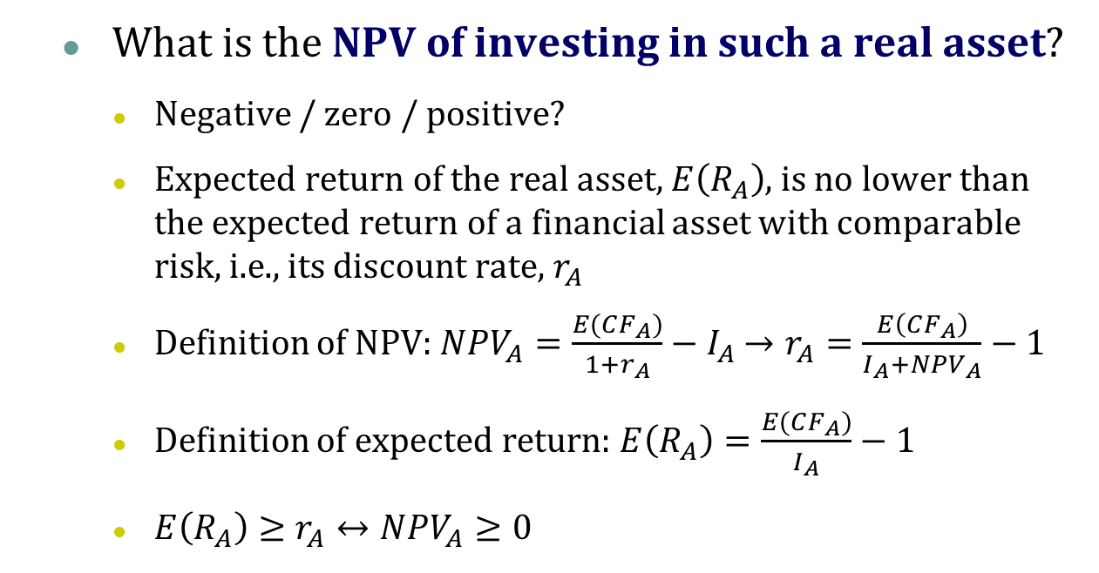
Real Assets
What is the NPV of investing in such a real asset?
Negative / zero / positive?
Expected return of the real asset, $E\left(R_{A}\right)$, is no lower than the expected return of a financial asset with comparable risk, i.e., its discount rate, $r_{A}$
Definition of NPV: $NPV_{A}=\frac{E(CF_{A})}{1+r_{A}}−I_{A}$ $→r_{A}=\frac{E\left(CF_{A}\right)}{I_{A}+NPV_{A}}−1$
Definition of expected return: $E\left(R_{A}\right)=\frac{E(CF_{A})}{I_{A}}−1$
$E\left(R_{A}\right)≥r_{A}↔NPV_{A}≥0$

Slide 37
Real Assets
The basic capital budgeting rule in corporate finance is to take positive NPV projects
Why can these investments make a positive NPV?
The corporate may have exclusive access to the project
Specialized in producing certain products
Have exclusive customer relationship
Hold patents / trade secrete on the technology
Natural monopoly
…

Slide 38
Example
Try it!
A company holds $80 cash today, and has access to one project that requires an initial investment of $80 tomorrow and yields either $100 or $110 with 50%-50% probability in one year.
The company is fully financed through equity.
The company’s manager has no agency problem (i.e., capital budgeting decision made based on the positive NPV rule).
There is no information asymmetry (i.e., the market has known about the project and formed rational belief about managerial decision).
Financial market is efficient and competitive.
Another financial asset that pays either $100 or $110 with 50%-50% probability is traded in the market at $90.
If you hold the company’s stock today, what’s your expected return for the next year?
Notes:
Wrong answer: 105/80 – 1 = 31.25%

Slide 39
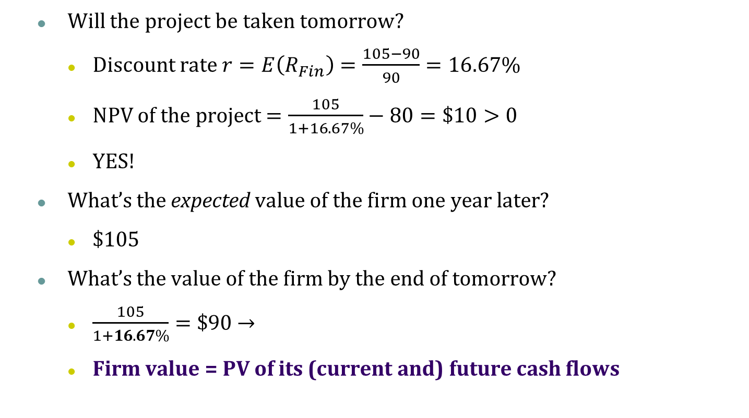
Example Cont.
Will the project be taken tomorrow?
Discount rate $r=E\left(R_{Fin}\right)=\frac{105−90}{90}=16.67\%$
NPV of the project $=\frac{105}{1+16.67\%}−80=\$10>0$
YES!
What’s the expected value of the firm one year later?
$105
What’s the value of the firm by the end of tomorrow?
$\frac{105}{1+16.67\%}=\$90$ →
Firm value = PV of its (current and) future cash flows
Notes:
NPV of the future projects goes to the existing shareholders
Recall: Goal of corporate finance is to maximize the current value of existing equity

Slide 40
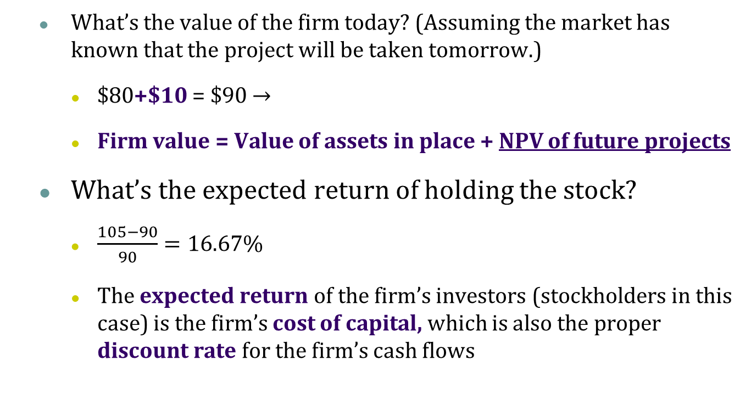
Example Cont.
What’s the value of the firm today? (Assuming the market has known that the project will be taken tomorrow.)
$80+$10 = $90 →
Firm value = Value of assets in place + NPV of future projects
What’s the expected return of holding the stock?
$\frac{105−90}{90}=16.67\%$
The expected return of the firm’s investors (stockholders in this case) is the firm’s cost of capital, which is also the proper discount rate for the firm’s cash flows
Notes:
NPV of the future projects goes to the existing shareholders
Recall: Goal of corporate finance is to maximize the current value of existing equity

Slide 41
Example Cont.
What if the market doesn’t know about the project today, and the manager announces it after it’s taken tomorrow?
The price today is $80.
The price will jump up to $90 after tomorrow’s announcement.
If you somehow knows about the project before other investors do, you will want to buy the stock today at $80 and sell it at $90 tomorrow.
Of course, if your purchase order is big, the other investors may infer that some good news is on the way and charge you higher than $80…

Slide 42
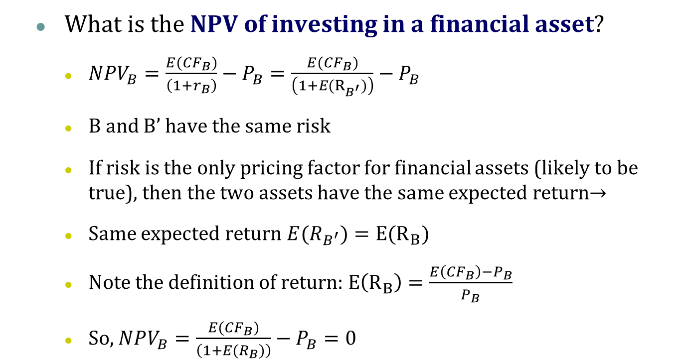
Financial Assets
What is the NPV of investing in a financial asset?
$NPV_{B}=\frac{E({CF}_{B})}{\left(1+r_{B}\right)}−P_{B}=\frac{E({CF}_{B})}{\left(1+{E(R}_{B^{′}})\right)}−P_{B}$
B and B’ have the same risk
If risk is the only pricing factor for financial assets (likely to be true), then the two assets have the same expected return→
Same expected return ${E(R}_{B^{′}})=E(R_{B})$
Note the definition of return: $E\left(R_{B}\right)=\frac{E\left(CF_{B}\right)−P_{B}}{P_{B}}$
So, $NPV_{B}=\frac{E({CF}_{B})}{\left(1+{E(R}_{B})\right)}−P_{B}=0$

Slide 43
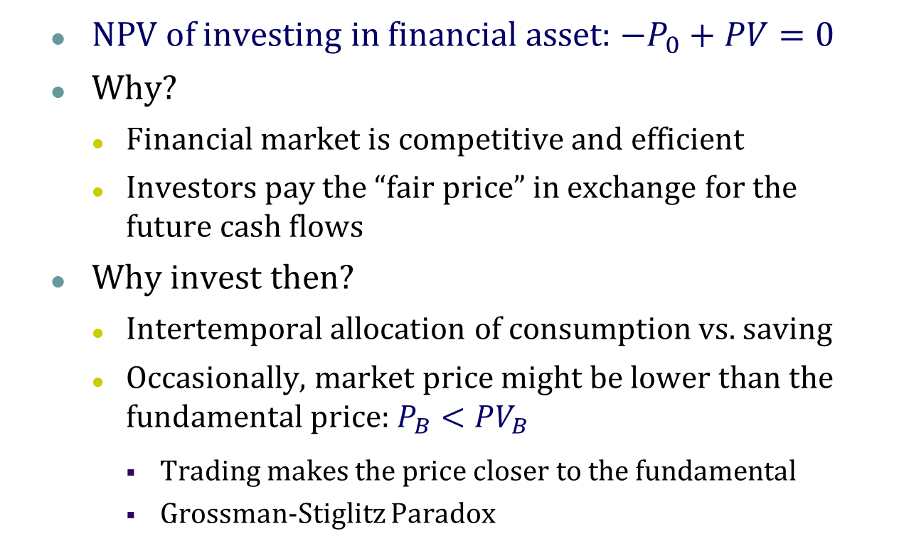
Financial Assets
NPV of investing in financial asset: $−P_{0}+PV=0$
Why?
Financial market is competitive and efficient
Investors pay the “fair price” in exchange for the future cash flows
Why invest then?
Intertemporal allocation of consumption vs. saving
Occasionally, market price might be lower than the fundamental price: $P_{B}<PV_{B}$
Trading makes the price closer to the fundamental
Grossman-Stiglitz Paradox

Slide 44
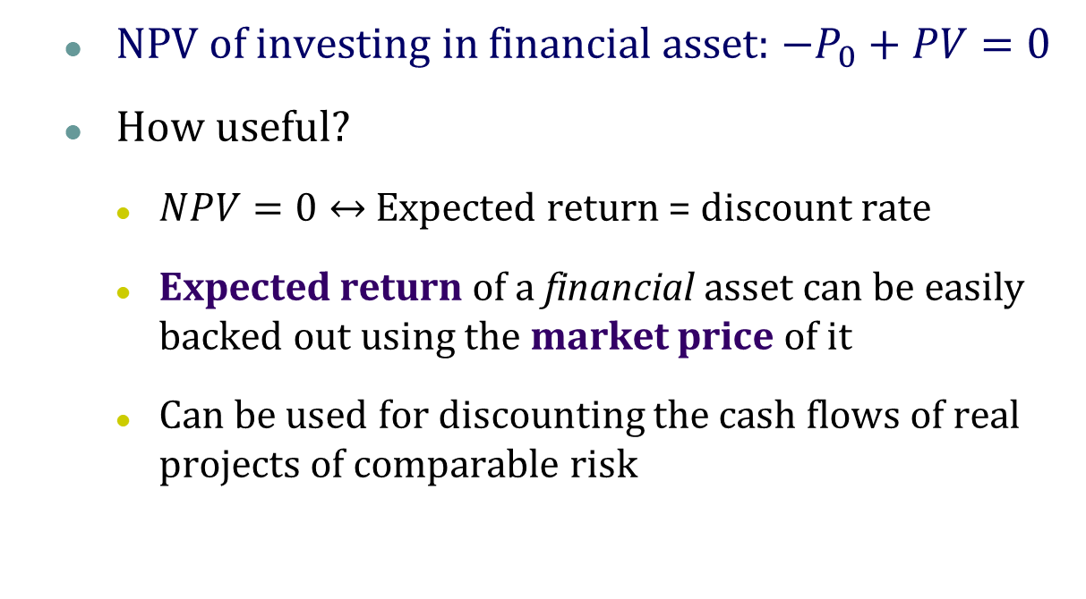
Financial Assets
NPV of investing in financial asset: $−P_{0}+PV=0$
How useful?
$NPV=0↔$ Expected return = discount rate
Expected return of a financial asset can be easily backed out using the market price of it
Can be used for discounting the cash flows of real projects of comparable risk

Slide 45
Cost of Capital
Cost of capital is the discount rate for cash flows of a company.
One of the main ingredients of any valuation or capital budgeting exercise is to determine the appropriate cost of capital for the firm’s cash flows or that of its projects.
For firms with both equity and debt, the cost of capital is the weighted average of cost of debt and cost of equity
This is called the weighted average cost of capital (WACC)

Slide 46
Value of a Firm
Value of a Firm = PV of the cash flows the firms is expected to generate now and in the future
Who receive the cash flows?
Investors: holders of the company’s stock and debt
PV of firm’s cash flows = PV of cash flows to stockholders + PV of cash flows to debtholders
Value of a Firm (V) = Market Value of Equity (E) + Market Value of Debt (D)
E = # of shares x Price per share
D = # of bonds x Bond Price or market value of private debt

Slide 47
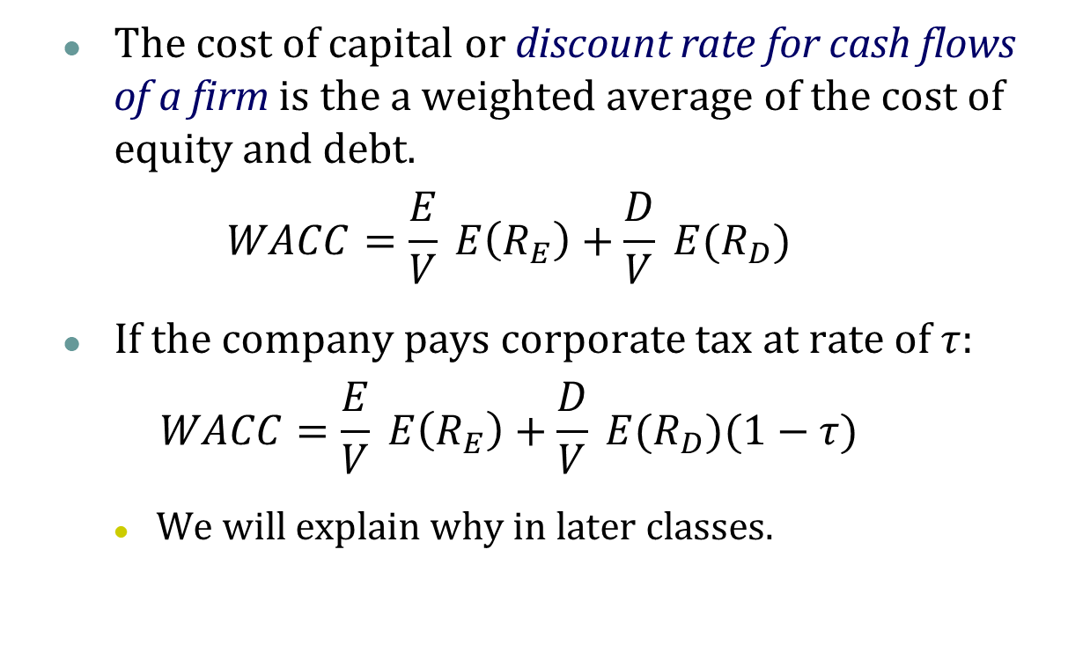
Cost of Capital
The cost of capital or discount rate for cash flows of a firm is the a weighted average of the cost of equity and debt.
$$WACC=\frac{E}{V} E\left(R_{E}\right)+\frac{D}{V} E(R_{D})$$
If the company pays corporate tax at rate of $τ$:
$$WACC=\frac{E}{V} E\left(R_{E}\right)+\frac{D}{V} E(R_{D})(1−τ)$$
We will explain why in later classes.

Slide 48
Takeaways
An asset creates value for its owner (investors) if it generates a positive value of cash flows.
NPV measures how much an investment adds value to the investors.
For a risky cash flow, the discount rate is the expected return on a financial asset of comparable risk.
In an efficient market, investing in financial assets earns zero NPV.
The capital budgeting rule of corporate finance (for real assets) is to take positive NPV projects.
Firm value incorporates the NPV of ongoing and potential projects.
The cost of capital or discount rate for cash flows of a firm is the a weighted average of the cost of equity and debt.

Slide 49
Excel Magic
Annuity present value
PV(r, T, C) (Note: NO period 0 cash flow)
Annuity future value
FV(r, T, C) (Note: NO period T cash flow)
Present value of uneven cash flows
NPV(r, value1:valueT) (Note: NO period 0 cash flow)
Return on an annuity - r
Rate(T, C, PV, FV)
Number of periods - T
NPER(r , C, PV, FV)
Constant payment - C
PMT(r, T, PV, FV)

Slide 50
What Next?
Capital Budgeting
Topic 2. Method comparison
What cash flows?
Topic 3. Accounting Review
Topic 4. Project Cash Flows (Free Cash Flow)
Case I.
What discount rate?
Weighted Average Cost of Capital
Topic 5. Bond Valuation (cost of debt)
Topic 6. Stock Valuation (cost of equity)
Topic 7. CAPM (expected return & risk; modern theory of asset pricing)

